Slide 1
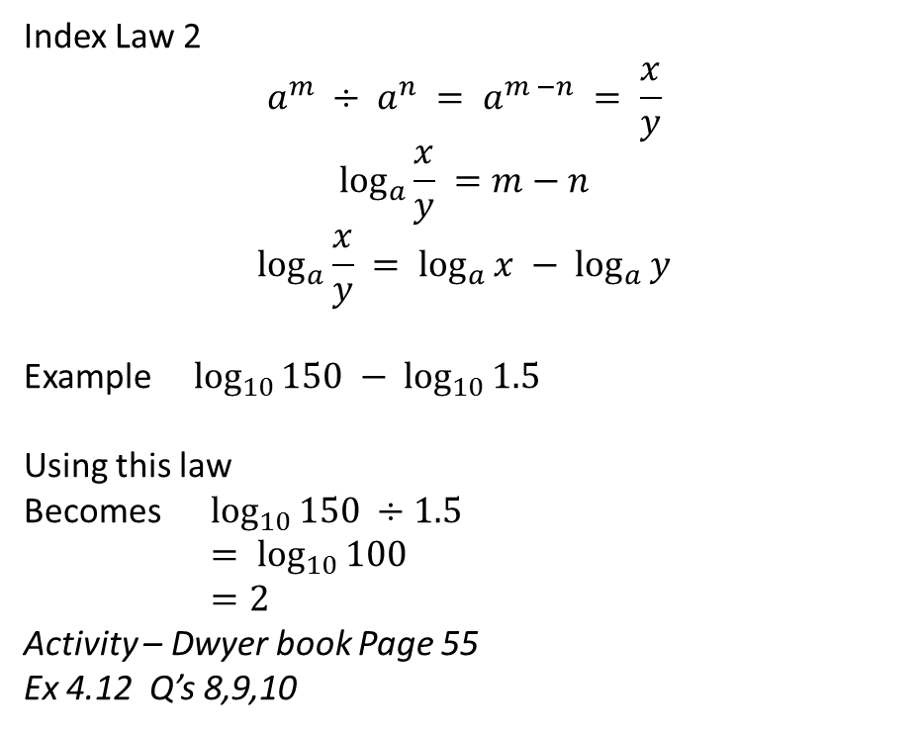
24
7
30
Date
Title - Mini Logarithm lesson 2
EQ – Logarithm Law v’s Index Law 2
Index Law 2
$$a^{m} ÷ a^{n} = a^{m −n} = \frac{x}{y}$$
$$\log_{a}{\frac{x}{y}} =m−n$$
$$\log_{a}{\frac{x}{y}} = \log_{a}{x} − \log_{a}{y}$$
Example $\log_{10}{150} − \log_{10}{1.5}$
Using this law
Becomes $\log_{10}{150 ÷1.5}$
$= \log_{10}{100}$
$=2$
Activity – Dwyer book Page 55
Ex 4.12 Q’s 8,9,10
5
Notes:
Input

Slide 2
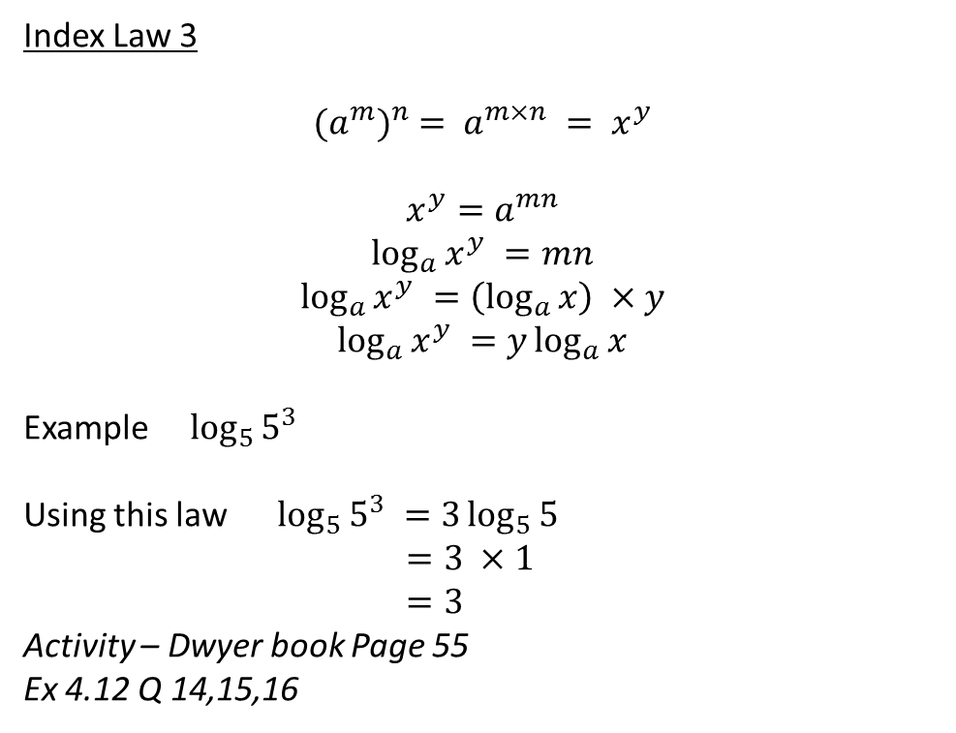
24
7
30
Date
Title - Mini Logarithm lesson 2
EQ – Logarithm Law v’s Index Law 3
Index Law 3
$${(a^{m})}^{n} = a^{m×n} = x^{y}$$
$$x^{y}=a^{mn}$$
$$\log_{a}{x^{y}} =mn$$
$$\log_{a}{x^{y}} =\left(\log_{a}{x}\right) ×y$$
$$\log_{a}{x^{y}} =y\log_{a}{x}$$
Example $\log_{5}{5^{3}}$
Using this law $\log_{5}{5^{3}} =3\log_{5}{5}$
$=3 ×1$
$=3$
Activity – Dwyer book Page 55
Ex 4.12 Q 14,15,16
5

Slide 3

24
7
30
Date
Title - Mini Logarithm lesson 2
EQ – Logarithm Laws v’s Negative Index Law
Negative Law
$$a^{−m} = \frac{1}{a^{m}}=\frac{1}{x}$$
In Log form $\log_{a}{\frac{1}{x}}= \log_{a}{x^{−1}}$
$$\log_{a}{\frac{1}{x}} =−1 ×\log_{a}{x}$$
$$\log_{a}{\frac{1}{x}} =−\log_{a}{x}$$
Example. $\log_{10}{\frac{1}{100}}$
Using Log Law
$$\log_{10}{\frac{1}{100}} =−\log_{10}{100}$$
$$\log_{10}{\frac{1}{100}} =−2$$
5
Notes:
Input

Slide 4

Activity
Evaluate the following
$\log_{3}{\frac{1}{9}}$ $\log_{5}{\frac{1}{25}}$ $\log_{4}{\frac{1}{16}}$
$\log_{10}{\frac{1}{1000}}$ $\log_{2}{\frac{1}{32}}$
Notes:
Independent practice

Slide 5
Closure
This lesson is on connect.
Homework – make sure your notes are complete
Complete summary
Complete questions from this lesson
Go to Mathspace and do activities you have not previously completed.
Notes:
Closure

